Slide 1
Welcome to Egeria Open Metadata and Governance

Slide 2
Agenda
09:30-10:15 What is open metadata and why do we need it
10:15-10:45 Basic concepts and integration patterns
10:45-11:00 Break
11:00-11:30 Demo of Egeria and Atlas
11:30-13:00 Deep dive into the Egeria code
13:00-14:00 Lunch
14:00-15:30 Egeria roadmap and brainstorm meeting
15:30-16:00 Summary, readout and next steps Room setup change.
18:00-19:30 Meet the experts social (beer, pizza, posters, demos, whiteboards)

Slide 3
Basic Concepts and Integration Patterns
Maryna Strelchuk
28 August 2018

Slide 4
Today’s reality

Slide 5
Open metadata management and governance
Search
Open Metadata Access Services
Open Metadata Repository Services

Slide 6
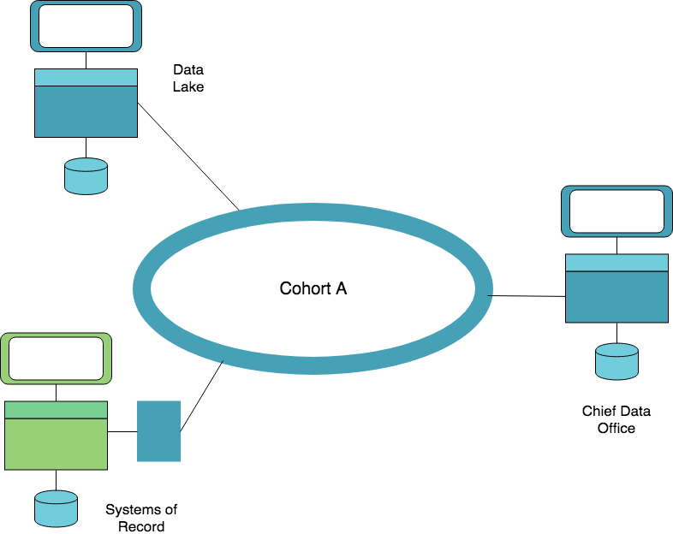
In a complex landscape there is a need to create subgroups
An Open Metadata Repository Cohort is a collection of the repositories that have been configured to work together.
Search

Slide 7
Egeria cohorts facilitate a more complex landscape
Open Metadata
&
Governance

Slide 8
Open metadata type model summary
Governance
Glossary
Collaboration
Models and
Reference Data
Lineage
Metadata
Discovery
Data Assets
Base Types, Systems
and Infrastructure

Slide 9
Each area caters for appropriate metadata structures
Strategy
4
Subject Area Definition
1
Teaming Metadata
(people profiles, communities, projects,
notebooks, …)
Policy Metadata (Principles, Regulations, Standards, Approaches, Rule Specifications, Roles and Metrics)
Business Objects and Relationships, Taxonomies and Ontologies
Augmentation
3
Organization
Feedback Metadata
(tags, comments, ratings, …)
Rollout
Classification
Business Attributes
Campaigns and Projects
Classification Schemes
Implementation
Mapping
Governance Actions and Processes
Rights
Management
Models and Schemas
2
Asset Collections
(Sets, Typed Sets, Type Organized Sets)
Reference Data
5
Instrument
7
Information Process
Instrumentation (design lineage)
Association
Information Views
Augmentation
Discovery
Metadata (profile data, technical classification, data classification,
data quality assessment, …)
Physical Asset Descriptions
(Data stores, APIs,
models and components)
0
Basic Types, Infrastructure and Systems
Access
6
Connectors

Slide 10
Inside the Open Metadata and Governance Server
Server Configuration

Slide 11
Major subsystems in OMRS
Server Configuration

Slide 12
Open Metadata Access Service (OMAS) instance

Slide 13
Example of a simple cohort
Data Lake
Cohort A
Chief Data Office
Systems of Record

Slide 14
Connecting to multiple cohorts
Data Lake
Marketing
Data Lake
Cohort A
Cohort B
Chief Data Office
Systems of Record
Systems of Record
Mobile
Apps

Slide 15
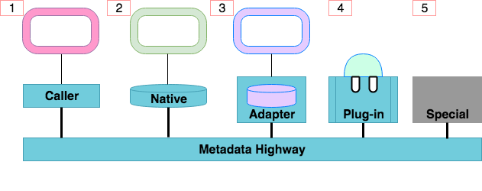
Open metadata and governance integration patterns
Apache Atlas
IBM Information Governance Catalog

Slide 16
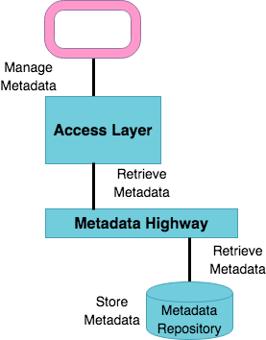
Caller integration pattern
A metadata tool can access the consumer-specific APIs to work with metadata.
The Access Layer handles the calls to metadata repositories connected to the metadata highway

Slide 17
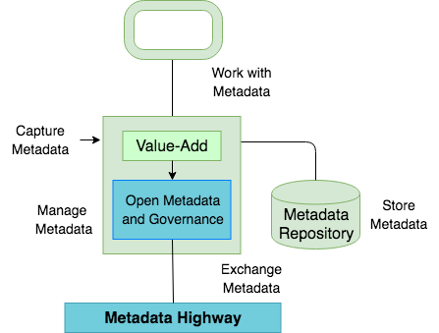
Native integration pattern
Native implementation of the open metadata governance APIs.
Apache Atlas is a native implementation of the open metadata and governance APIs.

Slide 18
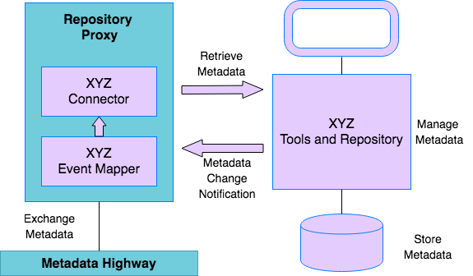
Adapter integration pattern
Simple components plug into a repository proxy to connect in an existing metadata repository.

Slide 19
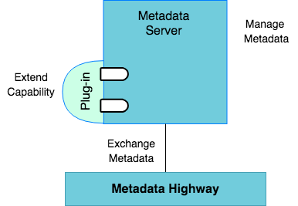
Plug-in integration pattern
Connector Framework (OCF)
Connectors to data, analytics etc
Open Discovery Framework (ODF)
Metadata discovery services
Governance action Framework (GAF)
Stewardship services for triage and remediation of exceptions

Slide 20
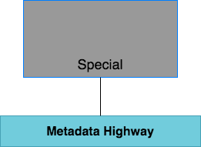
Special integration pattern
The tool, engine or data management platform implements its own version of the OMRS and OMASs.
This pattern should only be used if it is impossible to use one of the other patterns.

Slide 21
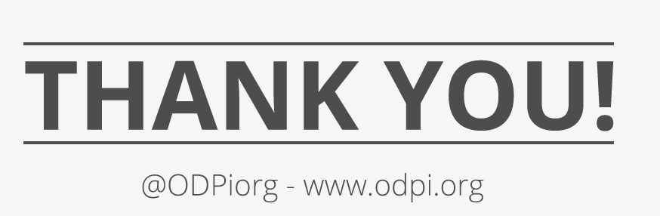

Slide 22
Coming up next
11:00-11:30 Demo of Egeria!
11:30-13:00 Deep dive into the Egeria code (10 mins each)
Design pattern for OMAS
Inside the OMRS
OCF and the Data Connector
How to integrate a new repository
Cohort setup, registration and exchange
Virtualizer and Ranger integration
Compliance test demo and philosophy

Slide 23
Demo of Egeria
Maryna Strelchuk and Ernie Ostic
28 August 2018

Slide 24
Deep dive into Egeria
David Radley, Susan Malaika, Nigel Jones, Maryna Strelchuk, Mandy Chessell
28 August 2018

Slide 25
Agenda
Design pattern for an OMAS
Inside the OMRS
OCF and the Data Connector
How to integrate a new repository
Cohort setup, registration and exchange
Virtualizer and Ranger integrator
Compliance test demo and philosophy
David Radley
Mandy Chessell
Nigel Jones
David Radley
Mandy Chessell
Nigel and Maryna
Mandy Chessell

Slide 26
Design pattern for an Open Metadata Assess Service (OMAS)

Slide 27
Open Metadata Management and Governance
Search
Open Metadata Access Services
Open Metadata Repository Services
https://github.com/odpi/egeria

Slide 28
General pattern for an OMAS

Slide 29
Understanding the tool / persona
Think “outside in”
Natural concepts for the tool or persona
How do the concepts relate?
What are the tasks and goals that the user needs to complete
How do the tasks relate to the lifecycle of the concepts
Paper prototype a UI (or flow diagrams if there is no UI)
Understand what operations are required using the OMAS concepts.
How does it position with the existing OMASs? Does it match an existing OMAS? Should it extend an existing OMAS (for the same persona). Is it an alternative implementation or a new one or one that has not been implemented yet.

Slide 30
Access Service mapping to OMRS service
OMAS request
OMAS
Open
Metadata
Types
Mapping OMAS to OMRS:
Need to map to the open metadata types
OMAS Concepts may need to flatten, aggregate entities, classifications, rename, remove, derive new content from one or more OMRS entities, relationships, classifications
OMRS
request
map
OMRS
OMRS
response
Java Classes for each
OMAS concept
OMAS response
Entity
Relationships
Classifications
…..

Slide 31
Egeria architecture with regard to access services
Access services are oriented towards a particular person / use case / tool.
Access services calls the Repository Services, to access metadata
Access services provide new APIs and a messaging interface,
Access services typically have these modules:
A client module – exposing a java API
A server module – exposing a Rest API and publishes events
A Spring server module
An API module with common API classes.

Slide 32
Implementation notes
An OMAS will need to be aware about optional capabilities that a repository might have:
for example the repository where a metadata instance is stored may or may not support soft-delete, or historical queries may not be supported.
An OMAS may be able to adapt its behavior depending on the types available in the underlying cohort.

Slide 33
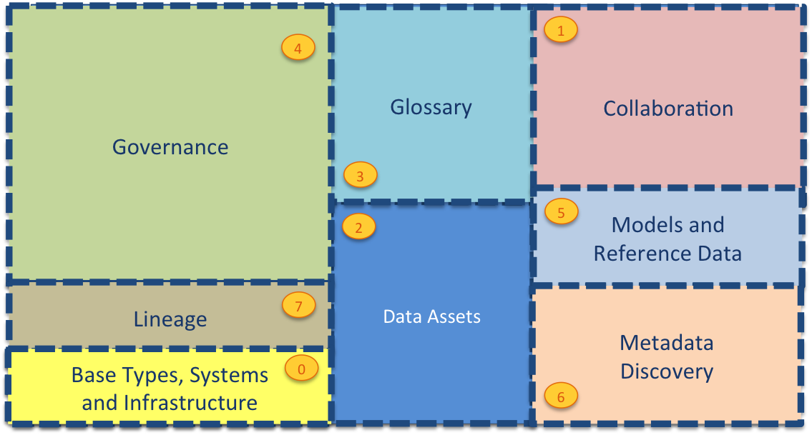
Current Open Metadata Access Services (OMASs)
Asset Consumer
Asset Owner
Asset Lineage
Subject Area
Asset Catalog
Community Profile
Stewardship Action
Project Management
Information View
Data Science
Governance Program
Software Developer
Data Privacy
Digital Architecture
Data Process
Data Protection
DevOps
Governance Engine
Data Infrastructure
Data Platform
Connected Asset
Discovery Engine

Slide 34
Inside the OMRS
Susan Malaika
28th August 2018
Notes:
Notes are here https://odpi.github.io/egeria/open-metadata-implementation/repository-services/docs/

Slide 35
Open Metadata Management and Governance
Search
Open Metadata Access Services
Open Metadata Repository Services

Slide 36
Inside the Open Metadata and Governance Server
Server Configuration

Slide 37
Subsystems in the OMRS
Server Configuration

Slide 38
Configuration options
Full Capability
Local only – no metadata sharing
No local repository (Caller Pattern)
No access services (Adapter Pattern)

Slide 39
Configuring the OMRS
The OMRS is configured using an administration services JSON document.
The top if the document identifies the server.
Below that, there is the configuration parameters of the access services (OMAS) and repository services (OMRS).

Slide 40
Repository services configuration structure
The repository services configuration is divided into sections for each subsystem.
Inside each section, is the configuration for a subsystem

Slide 41
More detail …
At this level of detail you can see the connectors for the different OMRS connectors
There are also the rules to control what metadata is shared:
Events to Save Rule
Events to Send Rule
Events to Process Rule

Slide 42
Conclusion
The Open Metadata Repository Services (OMRS) provides the ability for a metadata repository to connect and share metadata with other repositories.
It uses connectors to adapt to different runtime environments.
It is highly configuration so it can operate in different modes.
More information:
https://odpi.github.io/egeria/open-metadata-implementation/repository-services/docs/

Slide 43
Open Connector Framework (OCF) and the Data Connector

Slide 44
The Open Connector Framework (OCF)
The OCF is a metadata aware connector framework.
Every connector has a “data” interface and a metadata interface.
A metadata service (for example an OMAS) can be plugged in behind the metadata interface.
The OCF can be used to access data in data platforms

Slide 45
The Connection
What connector implementation to use
Connection
Connector Type
Endpoint
How to connect to the data assets

Slide 46
Connector APIs
initialize()
initializeConnectedAssetProperties()
start()
getConnectorInstanceId()
getConnection()
disconnect()

Slide 47
initialize()
initializeConnectedAssetProperties()
start()
getConnectorInstanceId()
getConnection()
disconnect()

Slide 48
Overview of OCF

Slide 49
OCF Connectors are used in OMRS
Server Configuration
Connectors

Slide 50
OCF Connectors are used in OMRS
Server Configuration
Next topic

Slide 51
How to integrate a new repository

Slide 52
Open Metadata Management and Governance
Search
Open Metadata Access Services
Open Metadata Repository Services

Slide 53
Egeria architecture with regard to repositories
An open metadata server can have an associated repository (store).
Inside the store is a metadata collection
Examples of products integrating repositories into Egeria
IBM Information Governance Catalog
Apache Atlas

Slide 54
Adding a repository
You need to write the code in Yellow
Repository connector maps repository service (OMRS) calls to your repository calls (open to your format)
Event mapper connector maps your repository events* to call to the OMRS
Repository operation** request
Repository connector
Access services
Repository services
Your metadata server
Open format
your format
Repository operation response
***
Event mapper connector
OMRS topic
Publish to cohort
* Repository events include entity created, relationship deleted, entity classified
**Repository operations include CRUD for Entities and relationships and search
*** Call repository connector to get more information

Slide 55
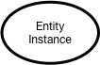
Instance representations in OMRS

Slide 56
Cohorts and relationships consideration
A cohort is a set of open metadata servers that share metadata.
Shared metadata from another server,
needs to stored with the metadata collection id of the originating server.
Reference Relationship instance
For example when a relationship is added by an open metadata server, there is a new relationship OMRS event published.
If the receiving server does not know about the entities, it must create entity proxies. These proxies are cut down versions of the real entities.
Entity
Proxy
Entity
Proxy

Slide 57
Homework prior to adding a repository
Assess which types you want to support (and are able to support)
Assess how you will map to the open types
Your connectors should be stateless.
Decide if you want to enhance your repository to make it easier to map to open metadata types or calls.
unique ids. status values, references, relationships , proxies
Which integration pattern? Caller, Adapter, Native, Plugin, Special
If using the native pattern then consider how the open metadata packages will integrate into your runtime. See Apache Atlas for an example on how to do this.

Slide 58
Cohort setup, registration and exchange

Slide 59
Example of a simple cohort
Data Lake
Cohort A
Chief Data Office
Systems of Record

Slide 60
First server
The first server to join the cohort issues a registration request and waits for others to join.

Slide 61
Establishing contact
When another server joins the cohort they exchange registration information.

Slide 62
Federated queries
Once the registration is complete the cohort members can query each other.

Slide 63
Caching metadata for availability and performance
Metadata can also be replicated through the cohort

Slide 64
Replication rules
Events to send
Events to process
Events to save
Access
Services
OMRS
OMRS Topic
Process
Send
Save

Slide 65
Bootstrapping the OMRS
As used of a member server issue queries for metadata the OMRS issues refresh events for any metadata that matches the “process” rule.
The owning server with the requested metadata sends a copy on the OMRS Topic. Any other member can consume this.

Slide 66
A word on metadata integrity
Home metadata collection is the only one who can edit
Every update (including undo and restore) increments the version number.

Slide 67
Conclusions
The OMRS supports both federated queries and replication of metadata.
Metadata servers join the cohort to share metadata.
The configuration of the metadata sharing is
Autonomic
Rule-driven

Slide 68
Virtualiser and Ranger integrator

Slide 69
Business meaning of the underlying assets
Business
metadata
IS-A
Employee
Sensitive
HAS-A
Work Location
HAS-A
HAS-A
Hourly Pay Rate
Manager
Compensation Plan
HAS-A
IS-A
HAS-A
Job Title
IS-A
HAS-A
Employee Id
Annual Salary
Employee Name
Structural
metadata for
a data store
EmpName
EmpNo
JobCode
Salary
Employee Record
Data
00 3809890 6 7 Lemmie Stage 818928 3082 4 New York 4 27 DataStage Expert 1 45324 300 27 Code St Harlem NY 1 3

Slide 70
Data virtualization layer
Search
Out Topic
Data Virtualization
Gaian
Business View
Virtualizer
Information View OMAS
Logical Tables
Technical View
In Topic
Mapping Logic

Slide 71
Compliance test philosophy and demo

Slide 72
Its an “imitation game”
Is this an open metadata server?
?
Compliance
Test

Slide 73
The repository connector’s metadata collection
Managing Type Definitions (TypeDefs)
Search and Query for metadata instances
Maintenance of metadata instances
Advanced maintenence
Maintenance of reference copies

Slide 74
Mandatory features
Support for at least one open metadata type:
Ability to exchange information the types supported by the repository using appropriate TypeDef and AttributeTypeDef structures.
Ability to create, update, delete, query and search for supported entities, classifications and relationships.
Ability to increment a version number within each metadata instance, each time it is changed.
Ability to ensure supported metadata instances conform to their type definition.

Slide 75
Optional features
Ability to programmatically create and maintain type definitions.
Ability to understand the relationships throughout the metadata using graph-like queries.
Ability to query the state of metadata from an historical point in time.
Ability to storing entity proxies as first class elements in the repository.
Ability to mark instances as deleted and restore them later. (soft-delete)
Ability to undo updates on metadata instances.
Ability to change the unique identifier (guid) of a metadata instance.
Ability to change the type of a metadata instance.
Ability to store and maintain reference copies of metadata from other open metadata repositories.

Slide 76
Compliance Testing
Code
Open Metadata Test Lab
Open Metadata Workbenches
Open Metadata Test Case
Compliance Report
Pass or fail
Discovered properties

Slide 78
Coming up next
13:00-14:00 Lunch
14:00-15:30 Egeria roadmap and brainstorm meeting
New requirements/Use cases
New products to integrate
Teaching materials and tutorials - what do we need?
Roadmap - presentation and discussion
Regional considerations - being both global and local

Slide 79
Egeria roadmap and brainstorm
Mandy Chessell
28th August 2018

Slide 80
Outline plan
Release 1 – August 2018
Release 2 – November 2018
Release 3 – January 2018

Slide 81
Current high priority backlog
Lineage
Sharing data and metadata between the organization.
Sharing metadata from BI tools.
Governance OMASs
Automatic metadata discovery
Automatic stewardship

Slide 82
Other requirements?
Integration (what tools should be integrated with Open Metadata)?
What OMASs are still needed and priorities to be developed?

Slide 83
How do we help people get started?
Teaching materials and tutorials - what do we need?

Slide 85
Coming up next
15:30-16:00 Summary, readout and next steps
18:00-19:30 Meet the experts social
beer, pizza, posters, demos, whiteboards

Slide 86
Egeria summary and roadmap
Mandy Chessell
28th August 2018

Slide 87
Today’s reality

Slide 88
Open metadata management and governance
Search
Open Metadata Access Services
Open Metadata Repository Services

Slide 89
Example of a simple cohort
Data Lake
Cohort A
Chief Data Office
Systems of Record

Slide 90
Connecting to multiple cohorts
Data Lake
Marketing
Data Lake
Cohort A
Cohort B
Chief Data Office
Systems of Record
Systems of Record
Mobile
Apps

Slide 91
Open metadata type model summary
Governance
Glossary
Collaboration
Models and
Reference Data
Lineage
Metadata
Discovery
Data Assets
Base Types, Systems
and Infrastructure

Slide 92
Current Open Metadata Access Services (OMASs)
Asset Consumer
Asset Owner
Asset Lineage
Subject Area
Asset Catalog
Community Profile
Stewardship Action
Project Management
Information View
Data Science
Governance Program
Software Developer
Data Privacy
Digital Architecture
Data Process
Data Protection
DevOps
Governance Engine
Data Infrastructure
Data Platform
Connected Asset
Discovery Engine

Slide 93
Each area caters for appropriate metadata structures
Strategy
4
Subject Area Definition
1
Teaming Metadata
(people profiles, communities, projects,
notebooks, …)
Policy Metadata (Principles, Regulations, Standards, Approaches, Rule Specifications, Roles and Metrics)
Business Objects and Relationships, Taxonomies and Ontologies
Augmentation
3
Organization
Feedback Metadata
(tags, comments, ratings, …)
Rollout
Classification
Business Attributes
Campaigns and Projects
Classification Schemes
Implementation
Mapping
Governance Actions and Processes
Rights
Management
Models and Schemas
2
Asset Collections
(Sets, Typed Sets, Type Organized Sets)
Reference Data
5
Instrument
7
Information Process
Instrumentation (design lineage)
Association
Information Views
Augmentation
Discovery
Metadata (profile data, technical classification, data classification,
data quality assessment, …)
Physical Asset Descriptions
(Data stores, APIs,
models and components)
0
Basic Types, Infrastructure and Systems
Access
6
Connectors

Slide 94
Inside the Open Metadata and Governance Server
Server Configuration

Slide 95
Major subsystems in OMRS
Server Configuration

Slide 96
Open metadata and governance integration patterns
Apache Atlas
IBM Information Governance Catalog

Slide 98
Coming up next
18:00-19:30 Meet the experts social
beer, pizza, posters, demos, whiteboards

